Slide 1
Title: Web Server Deployment and Access Management using AWS EC2
Department: Information Technology
Course Code: 6IT1284
Course Name: Hybrid Cloud Architecture and Management
Course Instructor: Dr Durgadevi P
Team Number: 06
Date: 01-04-2026
Team Members:
N Nandish-2023BIFT07AED040
Lokesh Naidu CH- 2023BIFT07AED033
Harshith Gowda M- 2023BIFT07AED052

Slide 2
Introduction
Cloud computing allows users to deploy applications and services over the internet instead of local servers.
Amazon Web Services (AWS) provides Elastic Compute Cloud (EC2) to create virtual machines in the cloud.
A web server can be deployed on EC2 to host websites and web applications.
Access management ensures that only authorized users can access and manage the server securely.
This project demonstrates how to deploy a web server on AWS EC2 and configure secure access using cloud security features.

Slide 3
Objectives
To understand the concept of cloud computing and AWS EC2.
To create and configure a virtual machine in AWS cloud.
To deploy a web server using Apache on EC2.
To implement secure access using security groups.
To host and access a webpage through the internet.

Slide 4
Problem Statement
Traditional web hosting requires high cost for physical hardware and maintenance.
Systems have limited scalability and cannot easily handle increasing user demand.
Upgrading resources (CPU, memory) is complex and may cause downtime.
Ensuring secure access and protection from unauthorized users is difficult.
Lack of centralized monitoring and remote management reduces efficiency.

Slide 5
Proposed Solution
Our proposed solution is to deploy a cloud-based web server using AWS EC2 with secure access management. The solution is divided into the following modules
Cloud Setup – Create and launch EC2 instance
Security Configuration – Configure security groups (SSH & HTTP)
Web Server Deployment – Install and configure Apache server
Web Page Hosting – Deploy HTML webpage
Access Management – Implement IAM for secure access
Testing & Verification – Access website using public IP

Slide 6
Technologies Used
Cloud Platform: Amazon Web Services (AWS)
Compute Service: EC2 (Elastic Compute Cloud)
Operating System: Ubuntu Linux
Web Server: Apache HTTP Server
Access Management: AWS IAM
Security: Security Groups (Firewall Rules)
Protocol Used: HTTP, SSH
Tools: Web Browser, Terminal / PuTTY

Slide 7
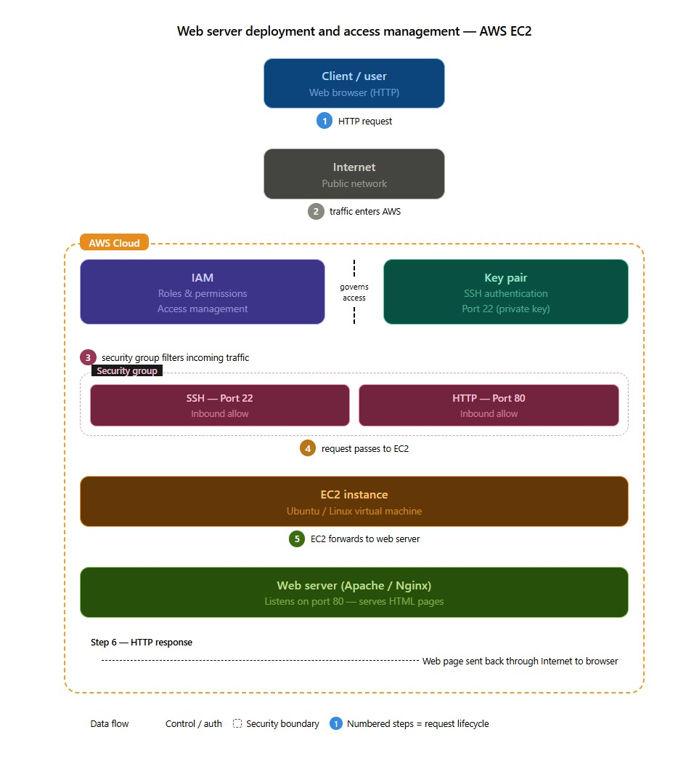
System Architecture
User sends request through web browser
Request passes through Internet to AWS Cloud
Security groups allow HTTP & SSH access
EC2 instance processes the request
Apache web server returns response

Slide 8
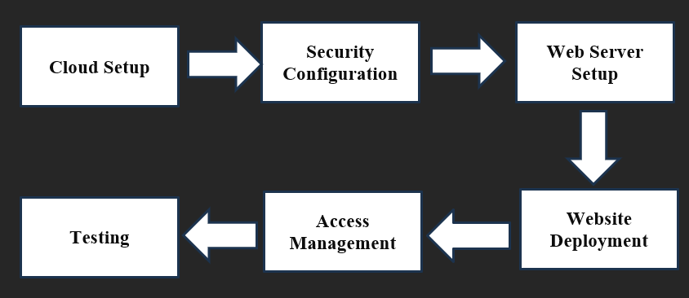
Methodology
Launch EC2 instance on AWS
Configure security groups (SSH & HTTP)
Install Apache web server
Deploy HTML webpage
Manage access using IAM
Test using public IP

Slide 9
Implementation
Launch EC2 instance on AWS
Configure security groups (HTTP & SSH)
Connect using SSH (key pair)
Install Apache web server
Deploy HTML webpage
Test using public IP

Slide 10
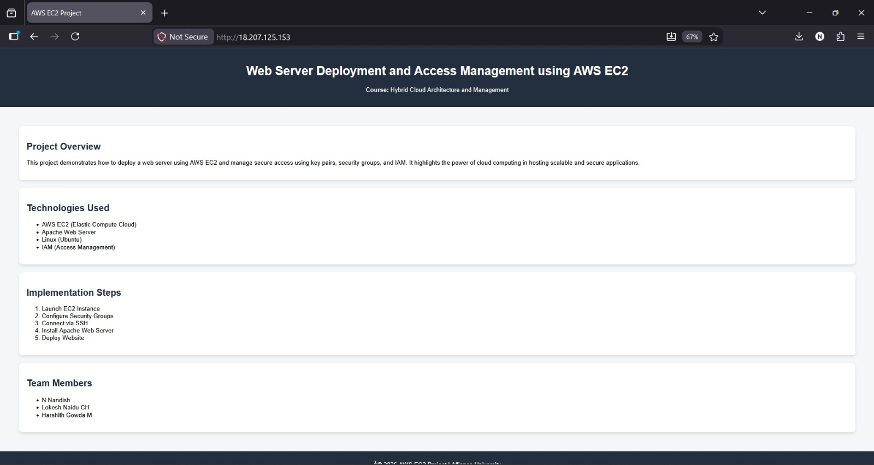
Results
Web Server Output Hosted on AWS EC2

Slide 11
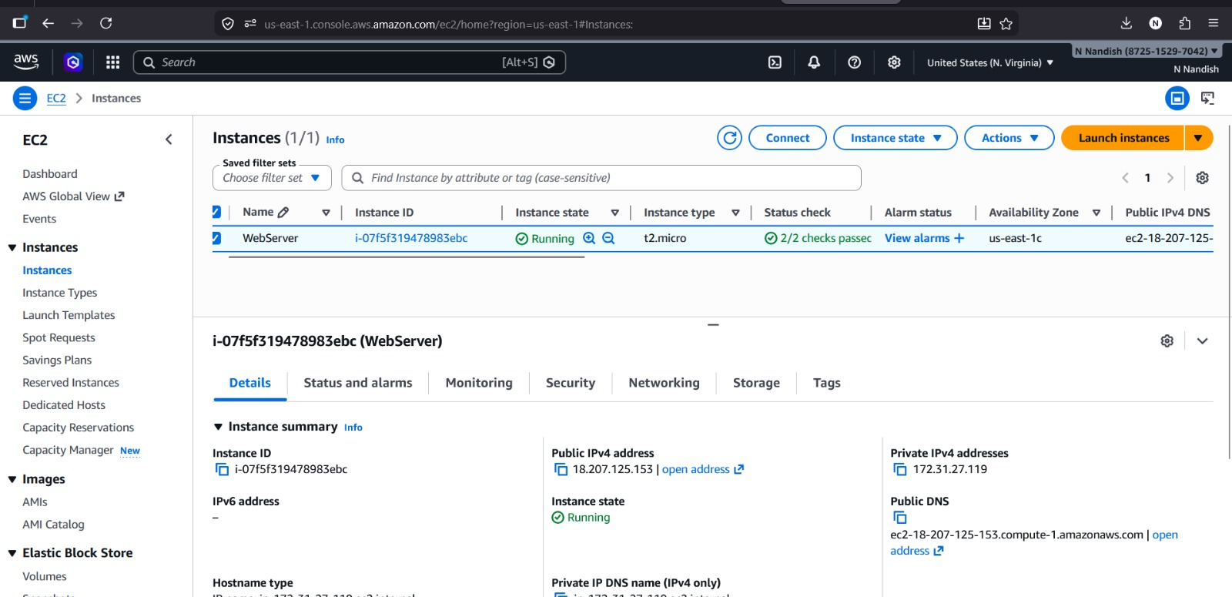
EC2 Instance Running Successfully

Slide 12
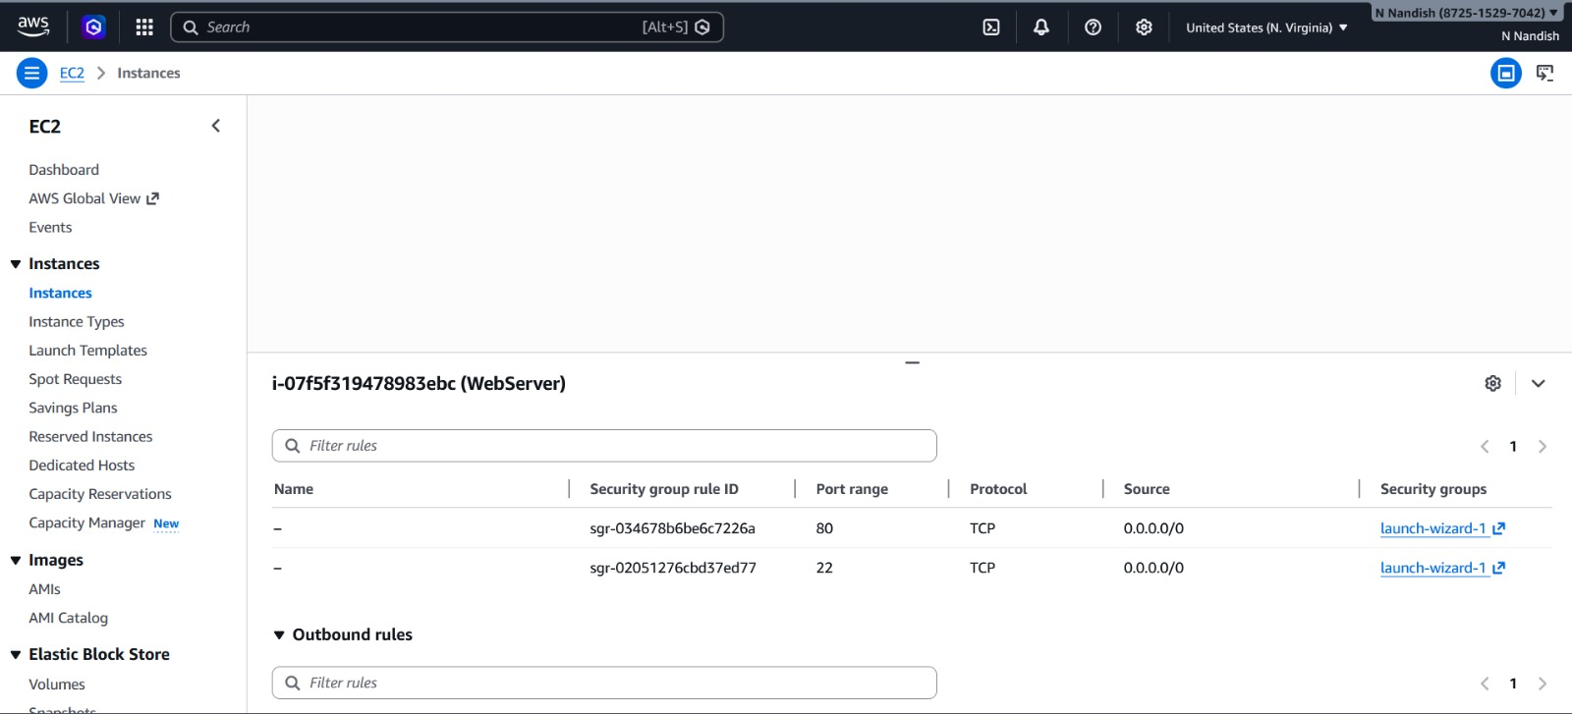
Security Group Configuration (HTTP & SSH Access)

Slide 13
Advantages & Limitations
Advantages:
Scalable and flexible infrastructure
Cost-effective (no physical hardware)
Easy deployment using AWS EC2
Secure access using IAM and SSH
Limitations:
Requires stable internet connection
Limited free-tier resources
Needs basic AWS knowledge
Security must be configured properly

Slide 14
Future Scope
Implement HTTPS using SSL for secure communication
Add load balancing and auto-scaling
Integrate database (AWS RDS) for dynamic applications
Use cloud storage (Amazon S3) for file management
Automate deployment using DevOps tools

Slide 15
Conclusion
Successfully deployed web server using AWS EC2
Implemented secure access using IAM and SSH
Webpage hosted and accessible via public IP
Demonstrated scalability and cloud efficiency
Gained practical knowledge of cloud deployment

Slide 16
References
Kurose, J. F., & Ross, K. W., Computer Networking: A Top-Down Approach
Buyya, R., Mastering Cloud Computing
Apache Software Foundation, Apache HTTP Server Documentation
Amazon Web Services, Amazon EC2 User Guide
Amazon Web Services, AWS Identity and Access Management (IAM) Documentation
Amazon Web Services, Security Groups for EC2 Instances
Ubuntu Documentation, Ubuntu Server Guide
Nginx Inc., Nginx Documentation

Slide 17


